Slide 1

ME 493 B.TECH PROJECT
AUTOMATION OF ABRASIVE CUTTING MACHINE
PRESENTED BY:
GANJI NITHIN KUMAR(220003029)
MANNEM HARI SHANKAR GOUD(220003051)
Under the guidance of:
Dr. Yuvraj K Madhukar(Associate Professor)
Department of Mechanical Engineering

Slide 2
OUTLINE
Introduction
Objective
Methodology
Components & classification
Mach3 Software
Block Diagram
Results & outcomes (current work done)
Conclusion
Future Work

Slide 3
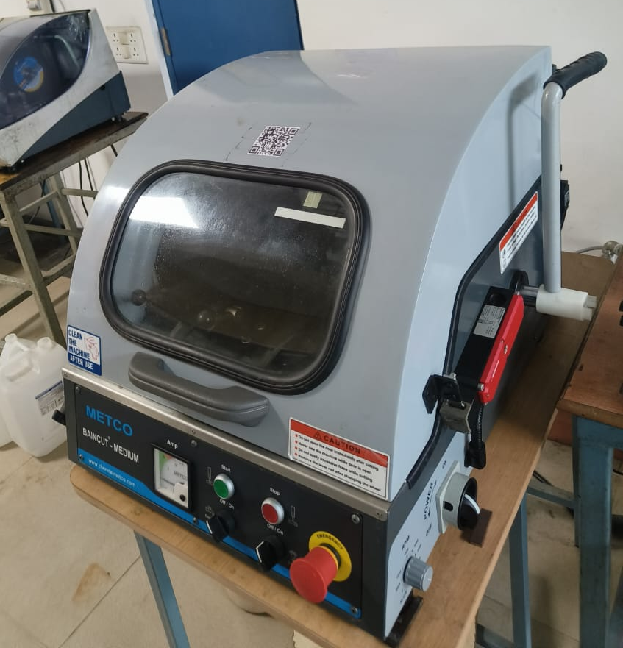
Abrasive Cutting Machine
Definition :
Abrasive cutting machines use a rotating abrasive wheel to cut hard materials by grinding rather than conventional sawing or chipping.
They are designed primarily for cutting metals, ceramics, composites, and other tough materials
The abrasive wheel is made of coarse particles like aluminum oxide, silicon carbide, or diamond bonded together in a matrix
It Produces clean cuts with minimal burr and reduced finishing work.

Slide 4
Objective
The main objective is to modify the manual abrasive cutting machine into automatic abrasive cutting machine.
Why do we have to modify a manual abrasive cutting machine into an automatic abrasive cutting machine?
Automatic abrasive cutting machines improve cutting speed and increase production efficiency compared to manual machines.
It improves operator safety by reducing direct contact.
Automated cutting uses less raw material, making it more eco-friendly.
Consistent, precise cuts with less human error.
Automatic abrasive cutting machines reduce long-term costs by lowering labor and material waste.

Slide 5
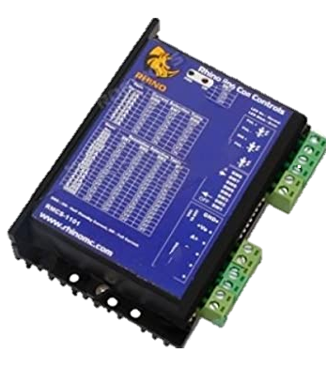
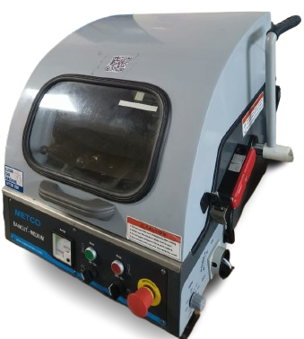
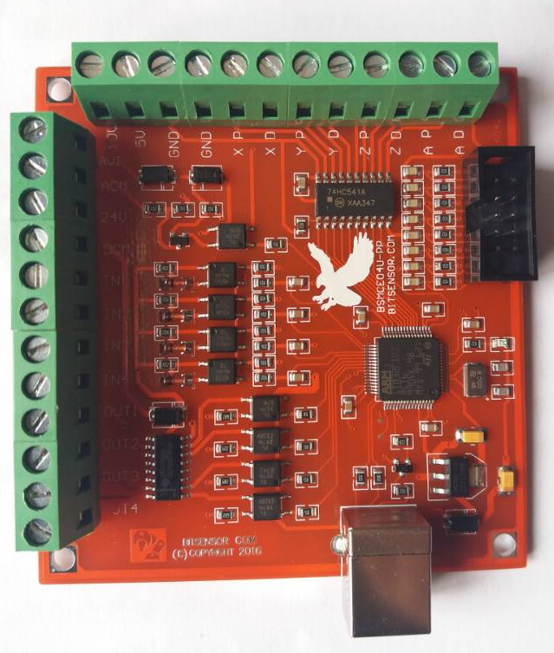
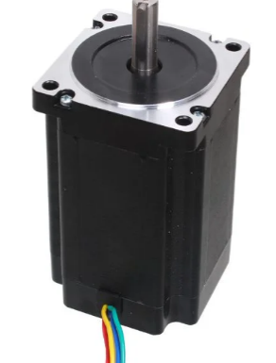
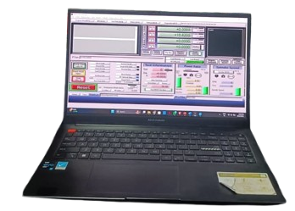
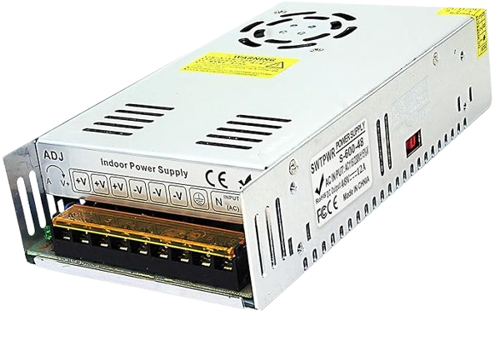
METHODOLOGY:
Stepper motor
Mach 3 cnc controller
Rhino motion control 1101
Abrasive cutting machine
Laptop with mach 3 software
Smps supply mode power switch

Slide 6
SMPS(Switched Mode Power Supply)
SMPS offers high efficiency (85-95%) power conversion, reducing energy loss and heat generation in abrasive cutting automation systems.
It provides stable and precise voltage regulation essential for sensitive CNC and automation equipment controlling abrasive cutting.
Compact and lightweight design helps optimize space in industrial automation panels and machines
Model | S-250
Output | +48V DC,5.2 A Max
input | 100-120V AC 5.0 A 200-240V AC 3.5 A
Terminals | Connections
V+ | +Ve in Driver Rmcs (1101)
V- | GND in Driver
N | Ac current
L | Ac current

Slide 7
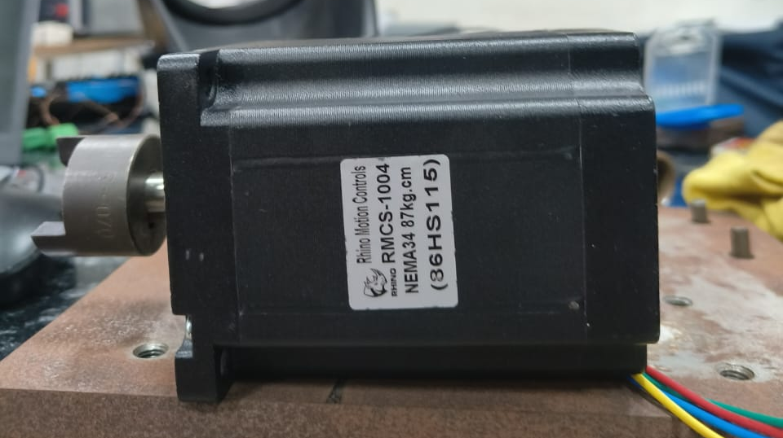
Stepper Motor
The motor is designed to work with typical stepper driver (RMCS 1101).
The motor enables precise positioning and speed control without requiring feedback sensors, suitable for automation applications.
It is use full for Industrial automation equipment requiring high torque and accurate positioning.
The RMCS 1004 stepper motor provides high holding torque (around 87 kg-cm), ideal for precise positioning needed in abrasive cutting operations.
Features:
Step Angle : 1.8 Degree
Configuration: 4 wire bipolar stepper motor
Holding Torque: 85kgcm bipolar mode
Phase current : 5Amp
Resistance/phase: 0.76ohm
Inductance/Phase : 8.5mH
Rotor inertia: 2700 gcm2
Length (L): 118mm
Shaft Dia : 12.7mm
Shaft Length : 32mm
Weight: 3800 grams
Terminal No | Terminal Name | Description | Wiring Details
1 | A+ | Motor Phase A+ | Red
2 | A- | Motor Phase A- | Green
3 | B+ | Motor Phase B+ | Yellow
4 | B- | Motor Phase B- | Blue

Slide 8
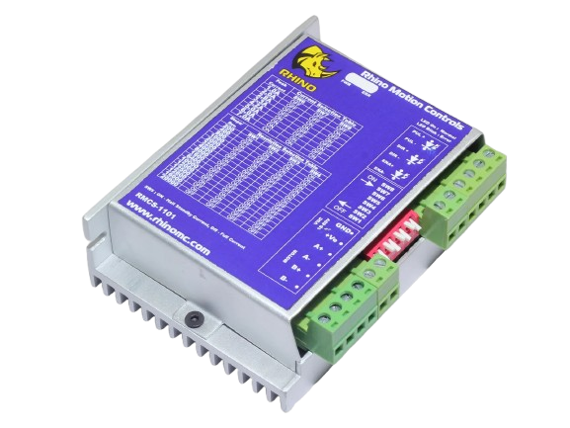
Rhino Motion Control Driver(1101)
RMCS 1101 is a micro stepping stepper motor driver designed for 4-wire bipolar stepper motors
It can handle supply voltages up to 80V and current up to 7.2A, suitable for driving robust stepper motors needed for abrasive cutting machines requiring high torque
RMCS-1101 supports high precision micro stepping control suited for smooth motion in abrasive cutting machine.
Terminal | Terminal Name | Description
1 | PUL+ | Pulse +ve connected to Y pulse in cnc controller.
2 | PUL- | Pulse -ve connected to GND in cnc controller.
3 | DIR+ | Direction +ve connected To Y Dir in cnc controller.
4 | DIR- | GND
5 | ENA+ | Optional
6 | ENA- | GND

Slide 9
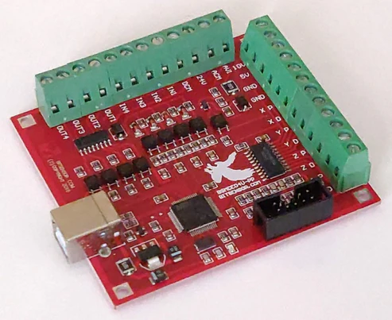
Mac 3 CNC Controller
CNC controller boards automate the precise movement of abrasive cutting machine components such as the cutting wheel and workpiece feed.
Provide step and direction signals for stepper motors like RMCS 1004 used in feed and positioning axes.
Interface with motor drivers to regulate spindle speed of the abrasive wheel for optimal cutting performance.
Terminal No | Terminal | Wiring
1 | GND | PUL-,DIR-,ENA- IN Rhino Motion
2 | X PUL | PUL+ In Rhino Motion
3 | X DIR | DIR + In Rhino Motion
4 | IN1 to IN4 | Limit switch (Future Work)
5 | USB | Connected with Laptop
Model | MACH3 4 Axis
Voltage | 24v
Year | 2021

Slide 10
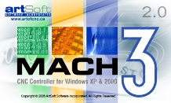
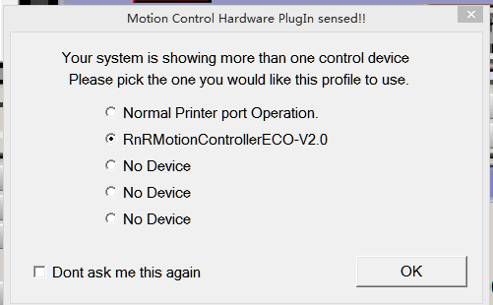
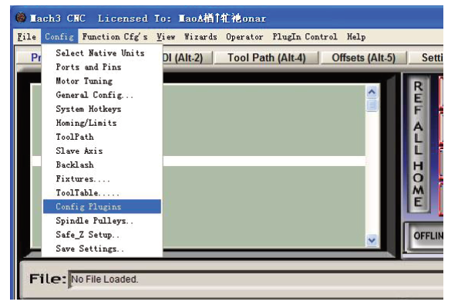
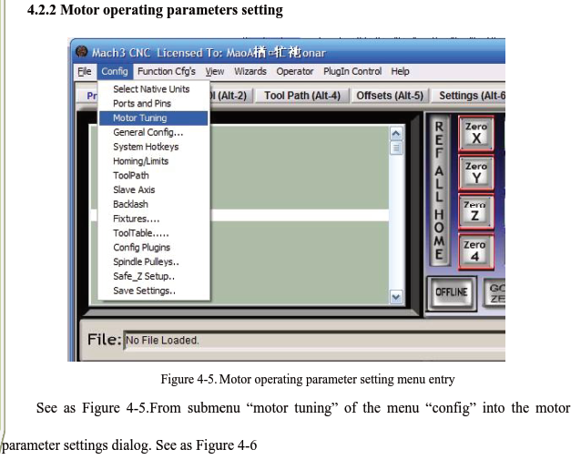
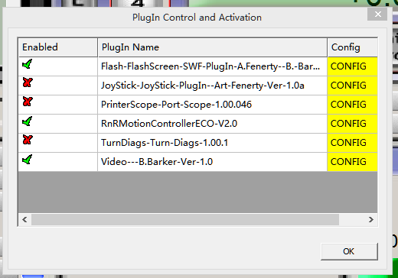
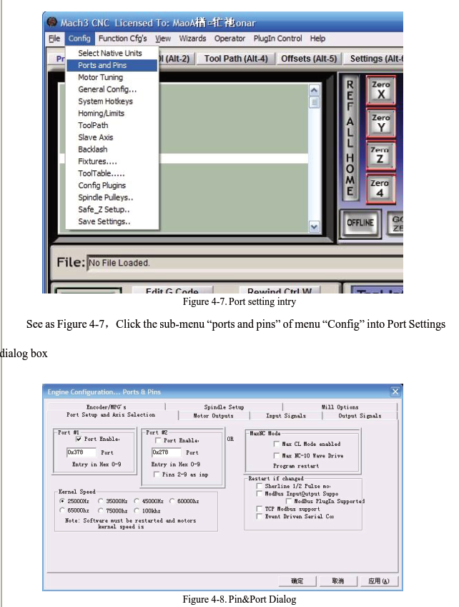
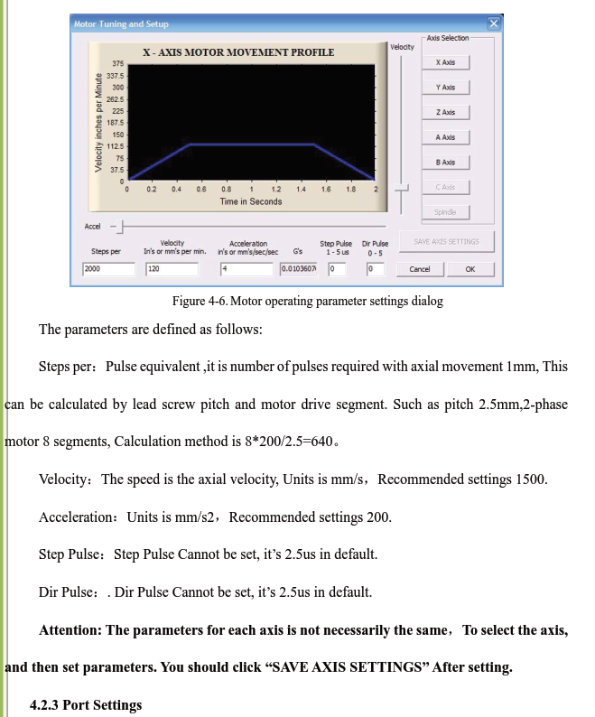
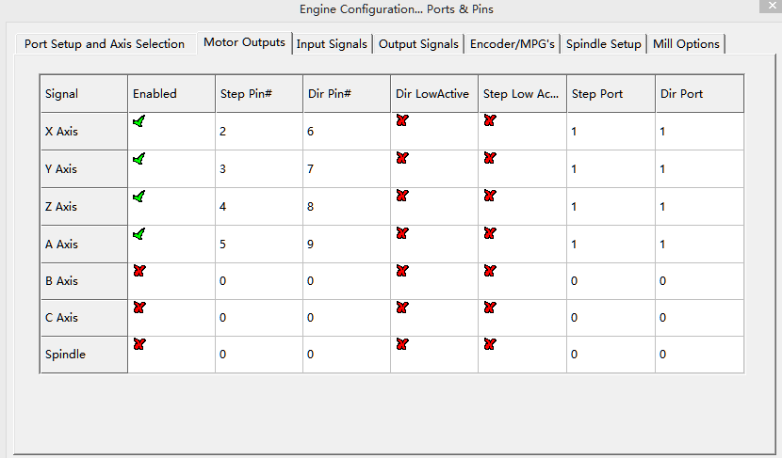
MACH 3 SOFTWARE
We Have to connect USB to CNC controller
1
2
3
4
5
6
7

Slide 11

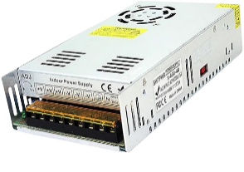
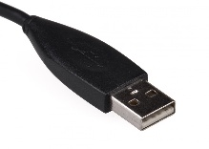

BLOCK DIAGRAM
RMCS-1101
DRIVER
SMPS
GND
N
PUL+
L
+Ve
PUL-
+V
A+
DIR+
-V
A-
DIR-
ENA+
B+
ENA-
B-
MOTOR
GND
X P
LAPTOP
MACH 3 SOFTWARE
X D
cnc controller

Slide 12
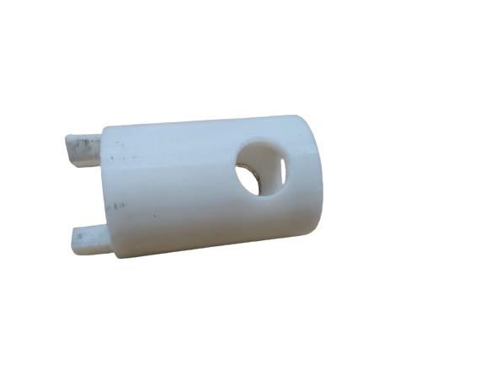
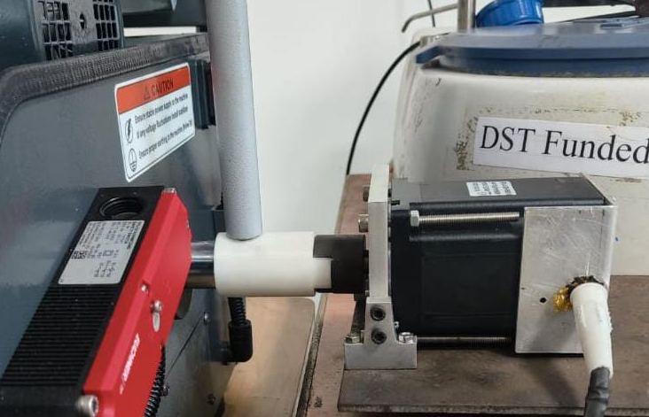
Coupler
Couplers connect the motor shaft to the abrasive cutting machine shaft for power transmission.
Protects motor and components from mechanical stress.
Couplers play a key role in maintaining the cutting accuracy and machine reliability in abrasive cutting operations.

Slide 13
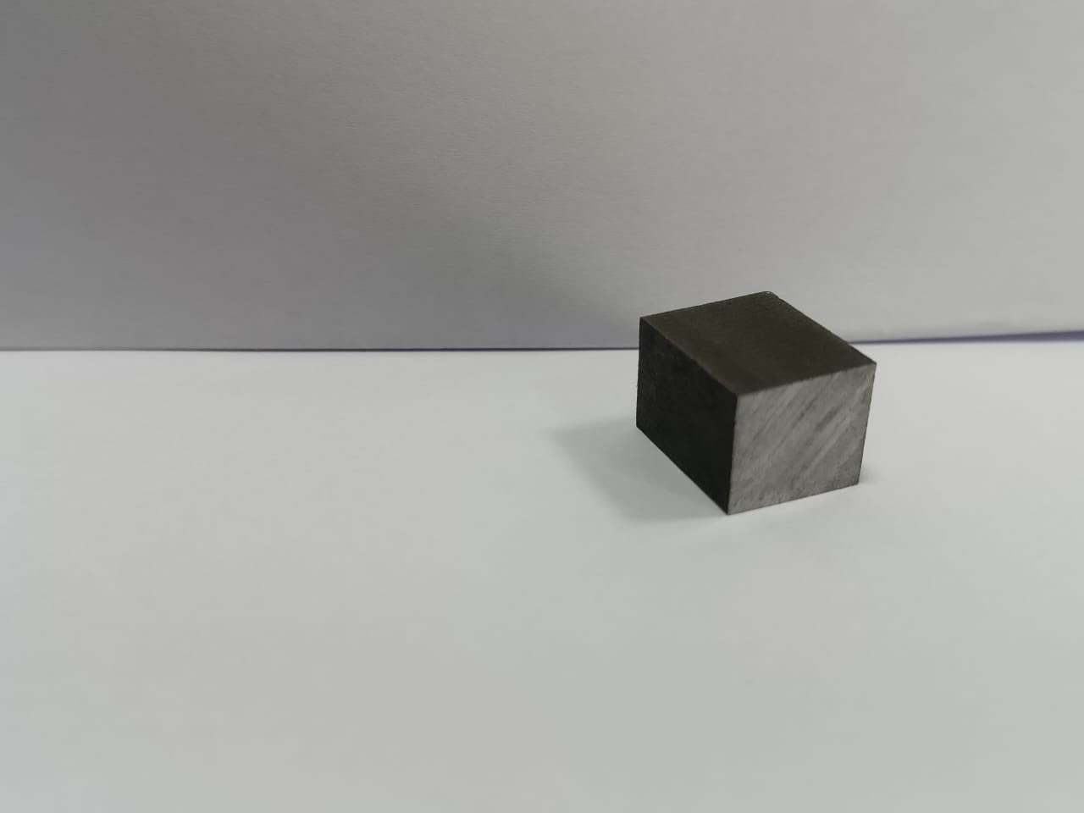
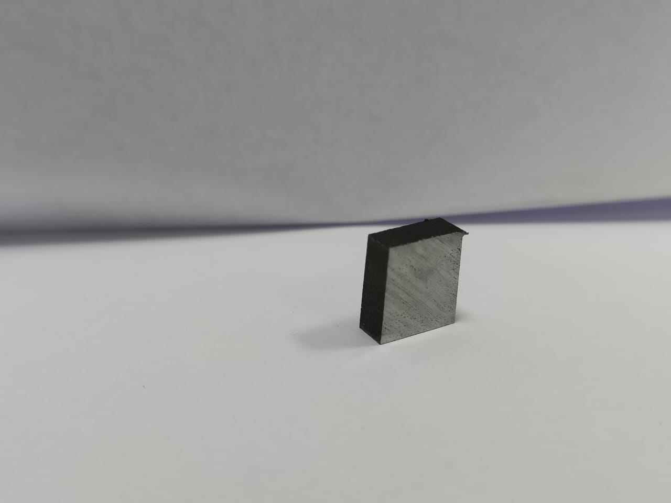
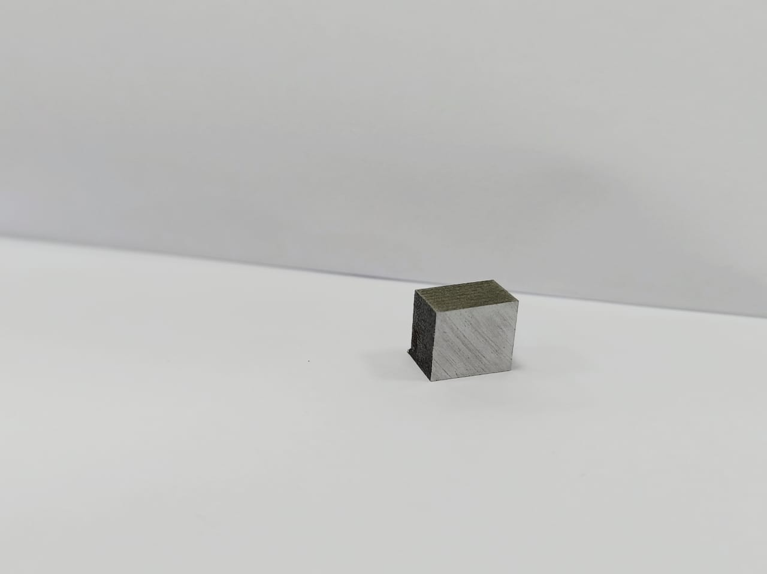
Readings & Outcome
These are the workpieces we have done with different RPM so that we have obtained these images attached below.
1000 RPM
2000 RPM
3000 RPM

Slide 14
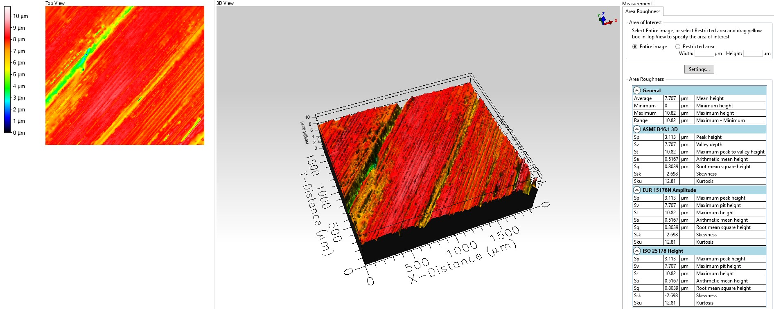
ROUGHNESSES OF MATERIAL
1000 RPM

Slide 15
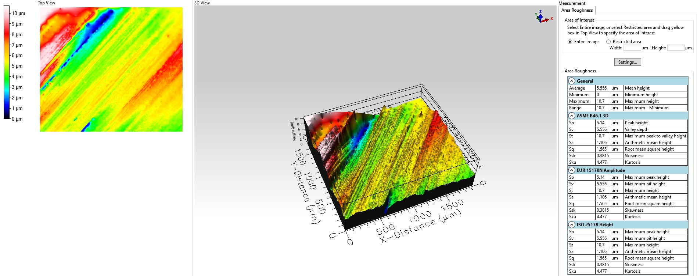
2000 RPM

Slide 16
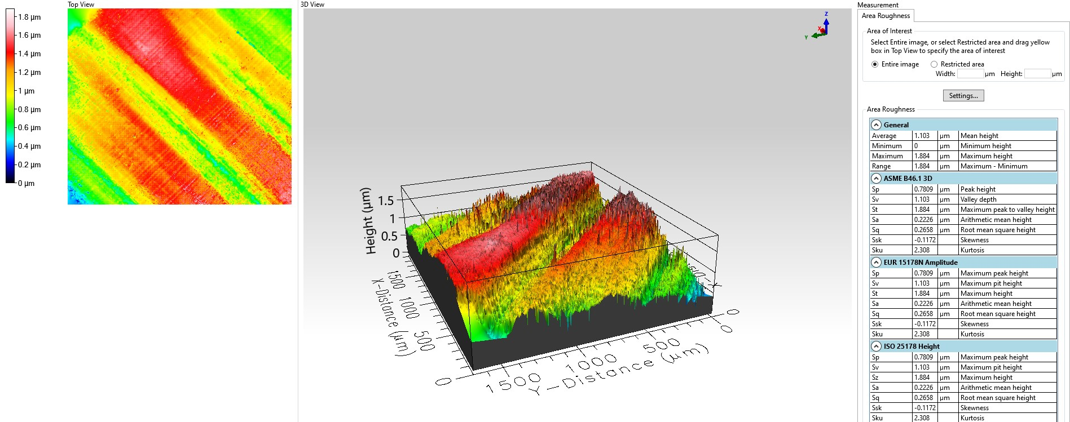
3000 RPM

